Slide 1
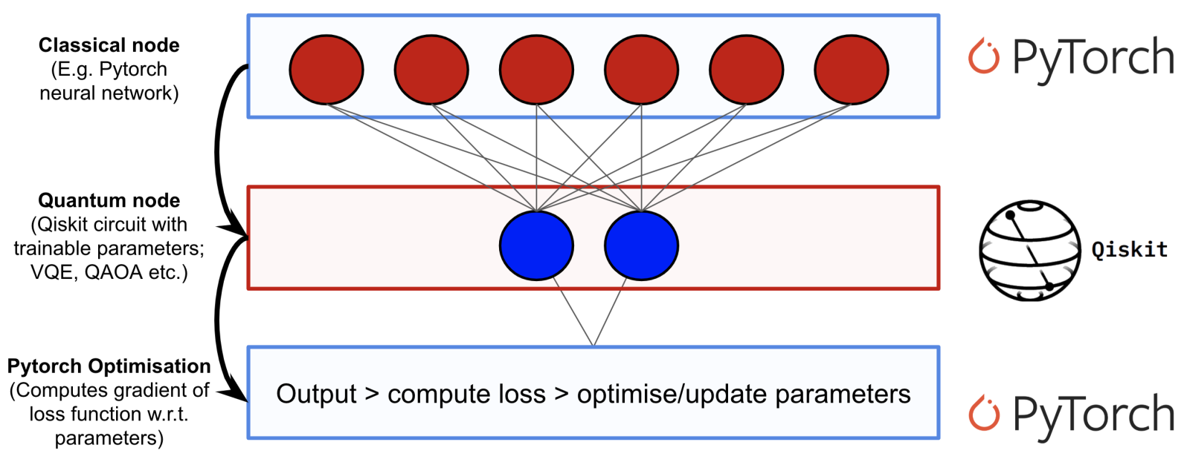
Qiskit and QML – 19th Nov 2020
Learn Quantum Computation using Qiskit

Slide 2
Agenda
8:15-9:00 Exam – multiple choice questions
9:00-9:15 Break
9:15-10:00 5 pages reports
10:00-10:15 Break
10:15-11:00 Exam – the rest
11:00-11:05 Break
11:05-11:30 Quantum Key Distribution BB84

Slide 3
1.1 Preliminaries
The background presented here on classical neural networks is included to establish relevant ideas and shared terminology; however, it is still extremely high-level. If you'd like to dive one step deeper into classical neural networks, see the well made video series by youtuber 3Blue1Brown. Alternatively, if you are already familiar with classical networks, you can skip to the next section.

Slide 4
Neurons and Weights
A neural network is ultimately just an elaborate function that is built by composing smaller building blocks called neurons. A neuron is typically a simple, easy-to-compute, and nonlinear function that maps one or more inputs to a single real number. The single output of a neuron is typically copied and fed as input into other neurons.

Slide 5
Neurons and Weights – cont’d
Graphically, we represent neurons as nodes in a graph and we draw directed edges between nodes to indicate how the output of one neuron will be used as input to other neurons. It's also important to note that each edge in our graph is often associated with a scalar-value called a weight. The idea here is that each of the inputs to a neuron will be multiplied by a different scalar before being collected and processed into a single value. The objective when training a neural network consists primarily of choosing our weights such that the network behaves in a particular way.

Slide 6
Feed Forward Neural Networks
It is also worth noting that the particular type of neural network we will concern ourselves with is called a feed-forward neural network (FFNN). This means that as data flows through our neural network, it will never return to a neuron it has already visited. Equivalently, you could say that the graph which describes our neural network is a directed acyclic graph (DAG). Furthermore, we will stipulate that neurons within the same layer of our neural network will not have edges between them.

Slide 7
IO Structure of Layers
The input to a neural network is a classical (real-valued) vector. Each component of the input vector is multiplied by a different weight and fed into a layer of neurons according to the graph structure of the network. After each neuron in the layer has been evaluated, the results are collected into a new vector where the i'th component records the output of the i'th neuron. This new vector can then be treated as an input for a new layer, and so on. We will use the standard term hidden layer to describe all but the first and last layers of our network.

Slide 8
2. So How Does Quantum Enter the Picture?
To create a quantum-classical neural network, one can implement a hidden layer for our neural network using a parameterized quantum circuit. By "parameterized quantum circuit", we mean a quantum circuit where the rotation angles for each gate are specified by the components of a classical input vector. The outputs from our neural network's previous layer will be collected and used as the inputs for our parameterized circuit. The measurement statistics of our quantum circuit can then be collected and used as inputs for the following layer. A simple example is depicted below:

Slide 9
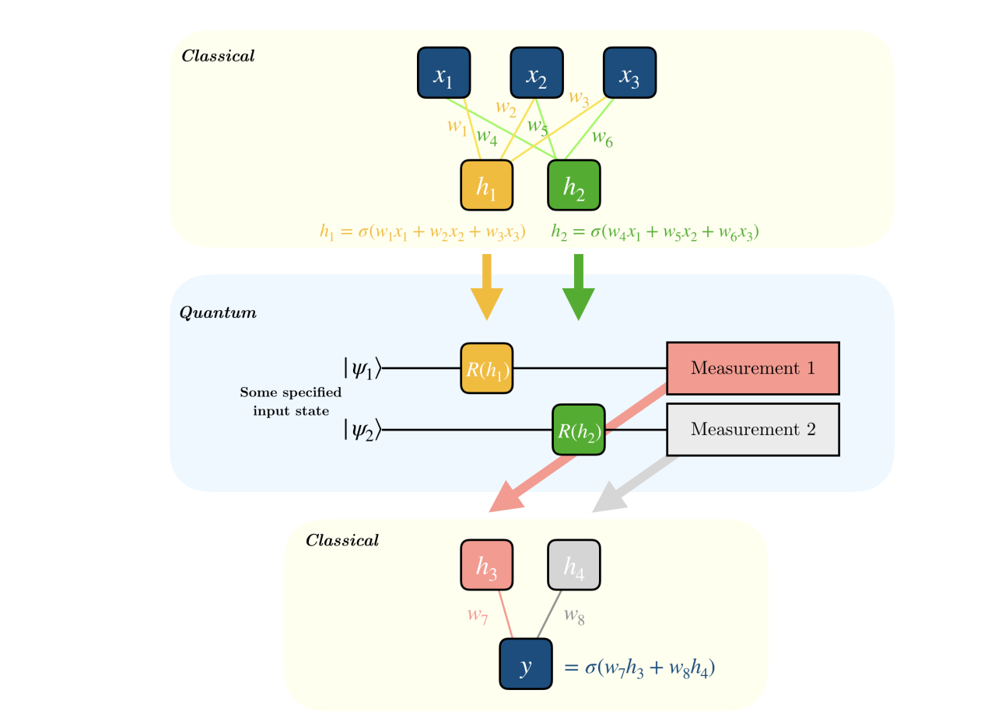
2. So How Does Quantum Enter the Picture?
Here, σσ is a nonlinear function and hihi is the value of neuron ii at each hidden layer. R(hi)R(hi) represents any rotation gate about an angle equal to hihi and yy is the final prediction value generated from the hybrid network.

Slide 10
Starting the Qiskit/mybinder.org
https://mybinder.org/v2/gh/Qiskit/qiskit-tutorial/master?filepath=index.ipynb

Slide 11
Qiskit and VQE Variational Quantum Eigensolver
https://www.youtube.com/watch?v=Z-A6G0WVI9w

